Slide 1


Exercise Planning
Overview

Slide 2
Introduction
Exercise Planning Concepts
Terminology
Standardization
HSEEP Compliance

Slide 3
HSEEP Concepts:
Overview
Standardized design and conduct, nationally
Common language and concepts
Meets NIMS goals
Synchronizes exercises, nationally
Provides tools to establish own self-sustaining exercise program
Capabilities-Based Planning
Notes:
- The Homeland Security Exercise and Evaluation Program (HSEEP) provides a set of guiding principles for exercise programs, as well as a common approach to exercise program management, design and development, conduct, evaluation, and improvement planning.
What is capabilities-based planning? Capability-Based Planning (CBP) was developed as an alternative to threat-based planning. It represents an attempt to break down traditional stovepipes and provide for transparency and coherence. CBP provides a more rational basis for making decisions on equipment acquisitions and training programs, and makes planning more responsive to uncertainty, economic constraints and risk. CBP provides a framework to support analysis and facilitate risk management. It focuses on goals and end-states and encourages innovation. It starts by asking questions regarding what do we need to do rather than what equipment are we replacing. Capabilities provide the means to accomplish a mission and achieve desired outcomes by performing critical tasks, under specified conditions, to target levels of performance.
In HSEEP, capabilities-based planning plays out in the evaluation process as capabilities-based evaluation. DHS has identified 37 target capabilities that describes the collective national capabilities required to prevent, protect against, respond to and recover from terrorist attacks, major disasters and other emergencies. More specifically, the list describes capabilities that states and communities and the private sector should collectively develop in order to respond effectively to disasters. No single entity will have all capabilities, but taken as a whole communities should achieve these foundational target capabilities.

Slide 4
Exercise Types
Discussion-Based
  Seminar
  Workshop
  Tabletop Exercise
  Game
Operations-Based
  Drill
  Functional
  Full-Scale
Notes:
There are seven types of exercises defined within HSEEP, each of which is either discussions-based or operations-based. Discussions-based Exercises familiarize participants with current plans, policies, agreements and procedures, or may be used to develop new plans, policies, agreements, and procedures.
Types of Discussion-based Exercises include:
■ Seminar. A seminar is an informal discussion, designed to orient participants to new or updated plans, policies, or procedures (e.g., a seminar to review a new Evacuation Standard Operating Procedure).
■ Workshop. A workshop resembles a seminar, but is employed to build specific products, such as a draft plan or policy (e.g., a Training and Exercise Plan Workshop is used to develop a Multi-year Training and Exercise Plan).
■ Tabletop Exercise (TTX). A tabletop exercise involves key personnel discussing simulated scenarios in an informal setting. TTXs can be used to assess plans, policies, and procedures.
■ Game. A game is a simulation of operations that often involves two or more teams, usually in a competitive environment, using rules, data, and procedure designed to depict an actual or assumed real-life situation.
Operations-based Exercises validate plans, policies, agreements and procedures, clarify roles and responsibilities, and identify resource gaps in an operational environment.
Types of Operations-based Exercises include: 
Drill. A drill is a coordinated, supervised activity usually employed to test a single, specific operation or function within a single entity (e.g., a fire department conducts a decontamination drill). 
Functional Exercise (FE). A functional exercise examines and/or validates the coordination, command, and control between various multi-agency coordination centers (e.g., emergency operation center, joint field office, etc.). A functional exercise does not involve any "boots on the ground" (i.e., first responders or emergency officials responding to an incident in real time). 
Full-Scale Exercise (FSE). A full-scale exercise is a multi-agency, multi-jurisdictional, multi- discipline exercise involving functional (e.g., joint field office, emergency operation centers, etc.) and "boots on the ground" response (e.g., firefighters decontaminating mock victims).

Slide 5
Documentation
Exercise Plan (EXPLAN)
Situation Manual (SITMAN)
Controller/Evaluator (C/E) Handbook
Master Sequence of Events List (MSEL)
Player Handout
Exercise Evaluation Guide (EEG)
After Action Report/Improvement Plan (AAR/IP)
Notes:
■ A Situation Manual (SitMan) is a participant handbook for discussion-based exercises, particularly TTXs. It provides background information on exercise scope, schedule, and objectives. It also presents the scenario narrative that will drive participant discussions during the exercise.
■ The Exercise Plan (ExPlan), typically used for operations-based exercises, provides a synopsis of the exercise and is published and distributed to players and observers prior to the start of the exercise. The ExPlan includes the exercise objectives and scope, safety procedures, and logistical considerations such as an exercise schedule. The ExPlan does not contain detailed scenario information.
■ The Controller and Evaluator (C/E) Handbook supplements the ExPlan for operations-based exercises, containing more detailed information about the exercise scenario and describing exercise controllers� and evaluators� roles and responsibilities. Because the C/E Handbook contains information on the scenario and exercise administration, it is distributed only to those individuals specifically designated as controllers or evaluators.
■ The Master Scenario Events List (MSEL) is a chronological timeline of expected actions and scripted events (i.e., injects) to be inserted into operations-based exercise play by controllers in order to generate or prompt player activity. It ensures necessary events happen so that all exercise objectives are met.
■ A Player Handout is a 1-2 page document, usually handed out the morning of an exercise, which provide a quick reference for exercise players on safety procedures, logistical considerations, exercise schedule, and other key factors and information.
■ Exercise Evaluation Guides (EEGs) help evaluators collect and interpret relevant exercise observations. EEGs provide evaluators with information on what tasks they should expect to see accomplished during an exercise, space to record observations, and questions to address after the exercise as a first step in the analysis process. In order to assist entities in exercise evaluation, standardized EEGs have been created that reflect capabilities-based planning tools, such as the Target Capabilities List (TCL) and the Universal Task List (UTL). The EEGs are not meant as report cards. Rather, they are intended to guide an evaluator痴 observations so that the evaluator focuses on capabilities and tasks relevant to exercise objectives to support development of the After Action Report/Improvement Plan (AAR/IP).
An After Action Report/Improvement Plan (AAR/IP) is the final product of an exercise. The AAR/IP has two components: an AAR, which captures observations and recommendations based on the exercise objectives as associated with the capabilities and tasks; and an IP, which identifies specific corrective actions, assigns them to responsible parties, and establishes targets for their completion. The lead evaluator and the exercise planning team draft the AAR and submit it to conference participants prior to an After Action Conference (see below). The draft AAR is distributed to conference participants for review no more than 30 days after exercise conduct. The final AAR/IP is an outcome of the After Action Conference and should be disseminated to participants no more than 60 days after exercise conduct.

Slide 6
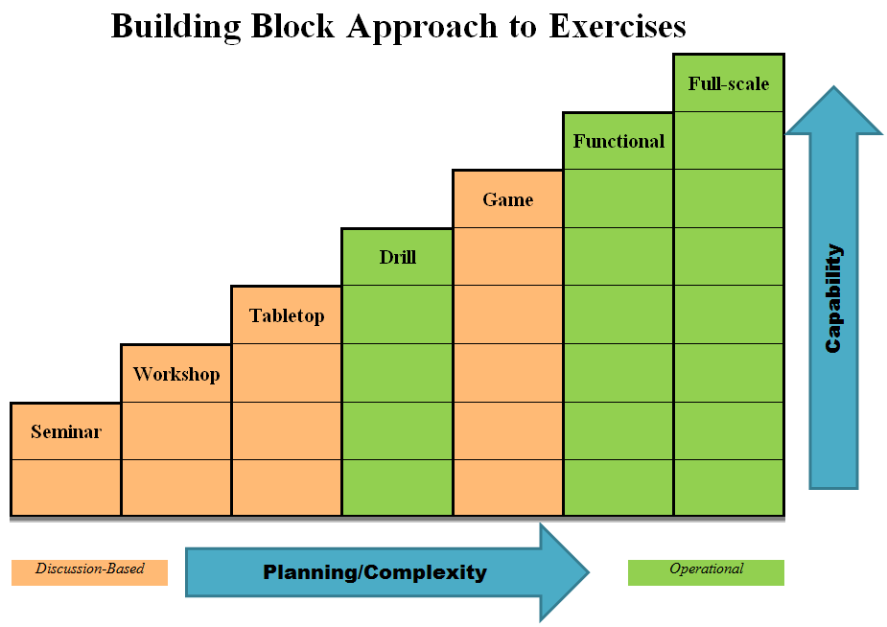
Terminology
Building Block Approach

Slide 7
Standardization
Meetings
    Concept & Objectives Meeting
    Initial Planning Conference (IPC)
    Mid-Planning Conference (MPC)
    Master Sequence of Events List Conference (MSEL)
    Evaluation Conference (EVAL)
    Final Planning Conference (FPC)
    After Action Conference (AAC)
Notes:
Exercise design and development includes the planning and document development process to support exercise conduct. Typical planning conferences/briefs included in an exercise design and development process include (depending on the type and complexity of the exercise):
Concept and Objectives Meeting
The C&O Meeting is the formal beginning of the exercise planning process. It is held to ensure that exercise planners agree upon the already-identified type, scope, capabilities, objectives, and purpose of the exercise. For less complex exercises and for entities with limited resources, the C&O Meeting can be conducted in conjunction with the Initial Planning Conference (IPC); however, when exercise scope dictates, the C&O Meeting is held first. Representatives from the sponsoring agency or organization, the exercise planning team leader, and senior officials typically attend the C&O Meeting to identify an overall exercise goal, develop rough drafts of exercise capabilities and objectives, and identify exercise planning team members.
IPC
The IPC is typically the first step in the planning process and lays the foundation for the exercise (unless a C&O Meeting is held). Its purpose is to gather input from the exercise planning team on the scope; design requirements and conditions (such as assumptions and artificialities); objectives; level of participation; and scenario variables (e.g., location, threat/hazard selection), and MSEL. During the IPC, the exercise planning team decides on exercise location, schedule, duration, and other details required to develop exercise documentation. Planning team members should be assigned responsibility for the tasks outlined in the conference.
MPC
The MPC, an operations-based exercise planning conference, is used to discuss exercise organization and staffing concepts; scenario and timeline development; and scheduling, logistics, and administrative requirements. It is also a session to review draft documentation (e.g., scenario, ExPlan, C/E Handbook, MSEL). (Note: A MSEL Conference can be held in conjunction with or separate from the MPC to review the scenario timeline for the exercise. An EVAL Conference can be held in conjunction with or separate from the MPC to review evaluation topics.)
MSEL
The MSEL Conference may be held in preparation for more complex, operations-based exercises, specifically to review the scenario timeline and focus on MSEL development.
EVAL
The EVAL Conference may be held in preparation for more complex, operations-based exercises, specifically to review the evaluation plan and exercise evaluation guide development.
FPC
The FPC is the final forum for the exercise planning team to review the process and procedures for exercise conduct, final drafts of all exercise materials, and all logistical requirements. During the FPC, there should be no major changes made to either the design or the scope of the exercise, nor to any supporting documentation. The FPC ensures all logistical requirements have been arranged, all outstanding issues have been identified and resolved, and all exercise products are ready for printing.
AAC
The AAC is the final forum for the exercise planning team to present, discuss, and refine the draft After Action Report (AAR), and to develop an Improvement Plan (IP). This conference is a chance to present the AAR to participating entities in order to solicit feedback and make necessary changes. A list of corrective actions should be generated identifying what will be done to address the recommendations, who (what agency or person) is responsible, and the timeframe for implementation.
IPW
The end product is a final Improvement Plan.

Slide 8

Questions

